Slide 1
MODULE II NOISE

Slide 2
NOISE- DEFINITION
In electrical terms, noise may be defined as an unwanted form of energy which tends to interfere with the proper reception and reproduction of transmitted signals.
For example, in receivers several electrical disturbances produce noise and thus modify the required signal in an unwanted form. In case of radio receivers, noise may produce this type of sound in the output of loudspeaker.
Similarly, in TV receivers, noise may produce 'snow' which becomes superimposed on the picture output.
In addition to this, in pulse communications, noise may produce unwanted pulses or cancel the required pulses. In other words, we can say that noise may limit the performance of a communication system.

Slide 3
Classification of Noise
Although there are several ways of classifying noise, conveniently noise may be classified into two broad groups as under:
(i) External Noise
(ii) Internal Noise

Slide 4
External noise
External noise may be defined as that type of noise which is generated external to a communication system i.e. whose sources are external to the communication system.
External noise cannot be analyzed quantitatively. In addition to this, for a given geographical point or location, external noise cannot be controlled.
Thus, to reduce the effect of external noise, the only way is to shift the communication system to another place or location which has comparatively smaller external noise.
Thus due to this reason, satellite earth stations are generally located in noise-free valleys.
External noise may be classified as under:
(i) Atmospheric Noise
(ii) Extraterrestrial Noise
(iii) Industrial Noise

Slide 5
Atmospheric Noise
Atmospheric noise, which is also called static, is produced by lightning discharges in thunderstorms and other natural electrical disturbances which occur in the atmosphere.
These electric impulses are random in nature. Thus this energy is spread over the complete frequency spectrum used for radio communication.
Atmospheric noise contains spurious radio signals which are distributed over a wide frequency range.

Slide 6
In fact, these spurious radio waves constituting the noise propagate over the earth in the manner as the required radio waves of the same frequency.
Thus, due to this reason, at any given receiving point, the receiving antenna picks up not only the required signal but also the static from all the thunderstorms.
Thus atmospheric noise becomes less severe at frequencies above about 30 MHz.

Slide 7
Extraterrestrial Noise
There are several types of extraterrestrial noise or space noise depending upon their sources. Extraterrestrial noise may be divided into the following two sub-groups.
(i) Solar Noise
(ii) Cosmic Noise
Solar Noise
Solar noise is the electrical noise emanating from the Sun. Under steady conditions, there is a regular radiation of noise from the Sun.

Slide 8
Cosmic Noise
Distant stars can also be considered Suns. These distant stars have high temperatures and therefore radiate noise in the same manner as the Sun.
The noise received from these distant stars is thermal noise and is distributed almost uniformly over the entire sky.

Slide 9
Industrial Noise
The industrial noise or man-made noise is that type of noise which is produced by such sources as automobiles and aircraft ignition, electrical motors, switch gears and leakage from high voltage transmission lines and several other heavy electrical equipments.
Such type of noise is produced by the arc discharge taking place during operation of all these machines or equipments.
Industrial or man-made noise is quite intensive in industrial areas, dense populated urban areas.
Industrial noise in such areas are much stronger than all other sources of noise in the frequency range extending from about 1 MHz to 600 MHz.

Slide 10
Internal noise
Internal noise is that type of noise which is generated internally or within the communication system or receiver. Internal noise may be treated quantitatively and can also be reduced or minimized by proper system design.
Since internal noise is randomly distributed over the entire frequency spectrum, the noise present in a given bandwidth B is the same at any frequency in the frequency spectrum.
Hence, this random noise power is proportional to the bandwidth over which it is measured.

Slide 11
Internal noise may be classified as under:
(i) Shot noise
(ii) Partition noise
(iii) Low frequency or Flicker noise
(iv) High-frequency or transit-time noise
(v) Thermal noise

Slide 12
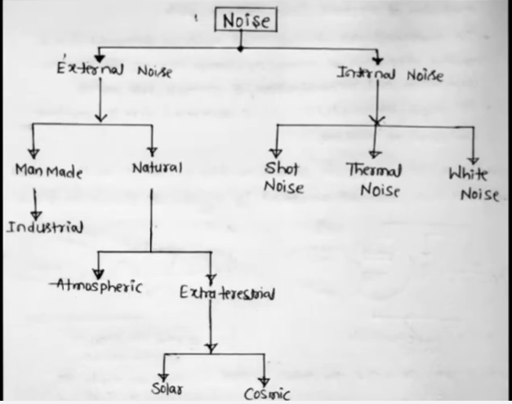

Slide 13
Shot Noise
Shot noise arises in active devices due to random behaviour of charge carriers.
In electron tubes, shot noise is generated due to the random emission of electrons from cathodes.
In semiconductor devices shot noise is generated due to the random diffusion of minority carriers or simply random generation and recombination of electron-hole pairs.

Slide 14
Shot Noise in Diodes
Based on current fluctuation in electronic devices
Current in electron devices flows as discrete pulses when electrons move from cathode to anode.
Shot noise is caused by random arrival of electrons and results in current fluctuation around the mean value.

Slide 15
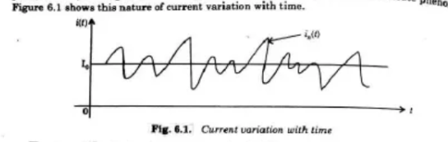
Current Fluctuation
Current fluctuates around a mean value I₀.
Actual current: i(t) = I₀ + iₙ(t)
I₀ = mean current
iₙ(t) = shot noise current

Slide 16
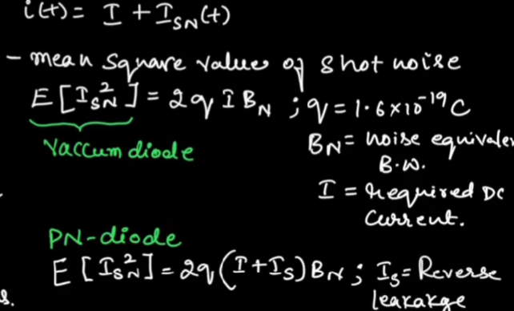

Slide 17
Shot Noise
Random fluctuation in current caused by discrete arrival of electrons.
The noise component iₙ(t) is random and cannot be predicted as a function of time.
Large number of electrons contribute to the noise.
By Central Limit Theorem, shot noise follows Gaussian distribution.

Slide 18
Power Density Spectrum
Power density spectrum of shot noise current:
Sᵢ(f) = q I₀
q = electronic charge
I₀ = mean current

Slide 19
Frequency Property
The power density spectrum is frequency independent within a certain range.
Transit time of electron:
τ = 3.36 d / √V μsec
Where d = distance between cathode and anode
V = anode voltage

Slide 20
Thermal Noise
Thermal noise (also called Johnson noise or white noise) is generated in a resistor due to the random motion of electrons, atoms and molecules.
The noise power produced in a resistor is proportional to its absolute temperature and also proportional to the bandwidth over which the noise is measured.
The maximum noise power of a resistor is given by:
Pₙ = k T B
Where:
k = Boltzmann constant (1.38 × 10⁻²³ J/K)
T = Absolute temperature (Kelvin)
B = Bandwidth (Hz)

Slide 21
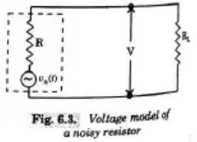
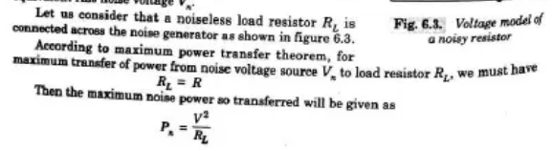
Voltage Model of a Noisy Resistor A resistor can be represented by an equivalent circuit consisting of a noise voltage source in series with the resistor. This model is called the voltage model of a noisy resistor.

Slide 22
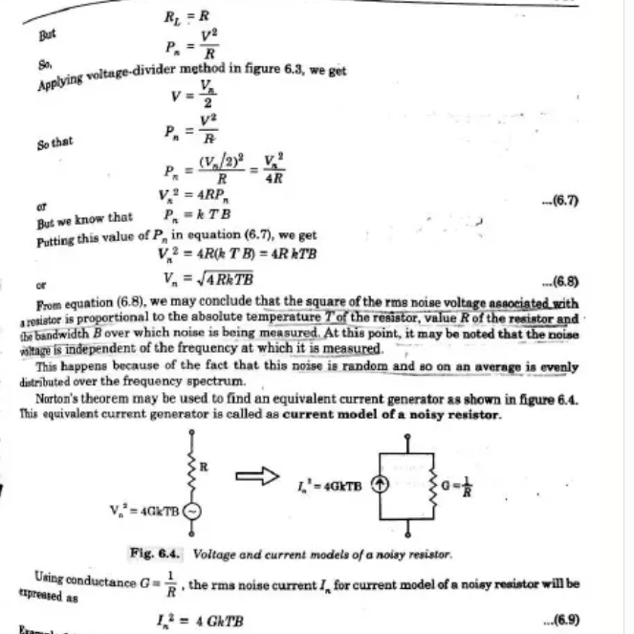

Slide 23
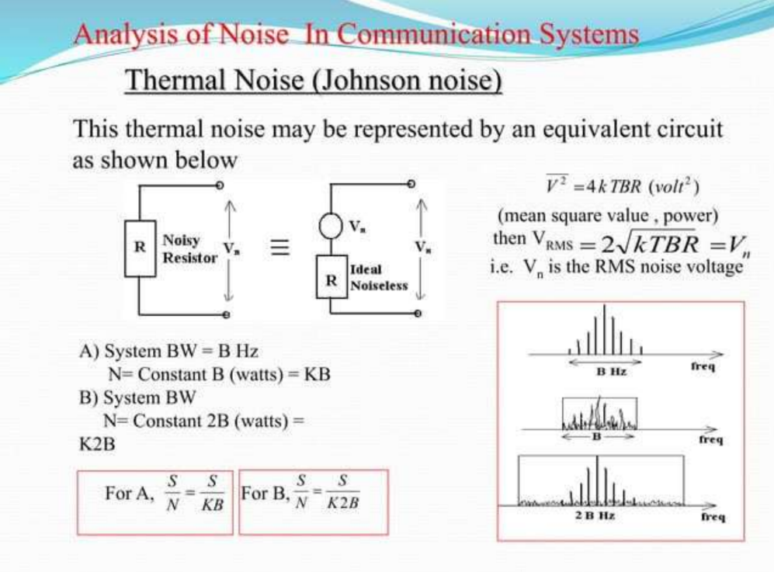

Slide 24
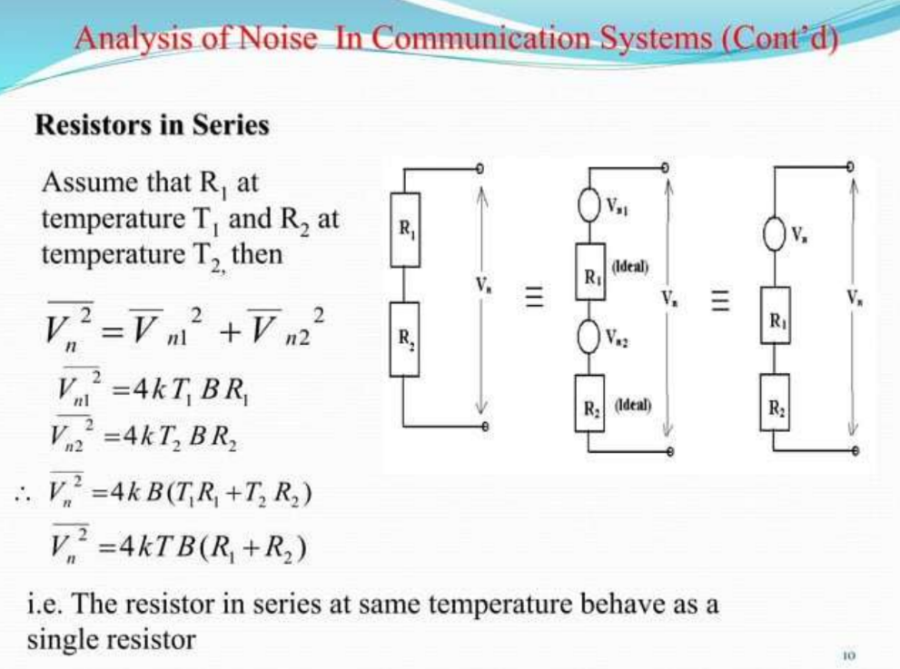

Slide 25
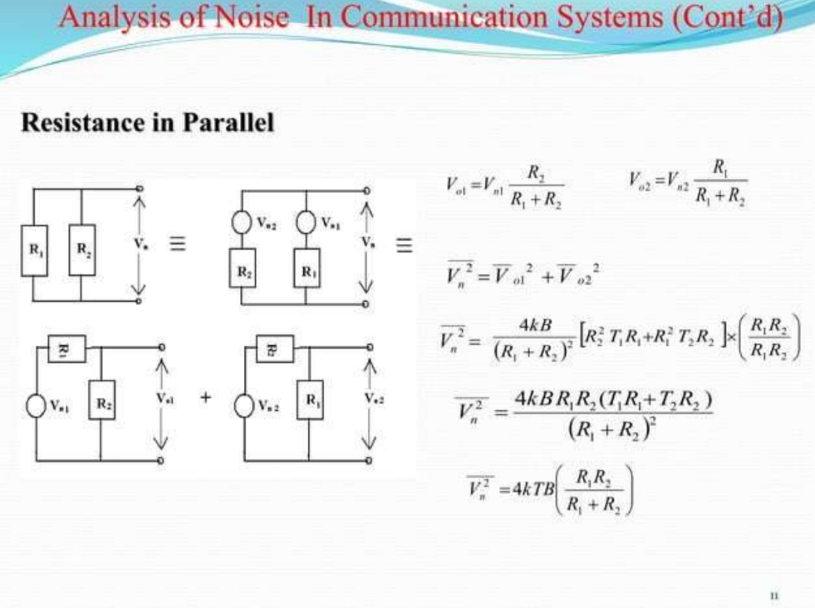

Slide 26
White Noise
Noise in an idealized form is known as white noise. In communication system analysis an idealized form of noise is often assumed, called white noise.
White light consists of all colour frequencies in equal amount. In the same way white noise contains all frequencies in equal amount.
The power density spectrum of white noise is independent of frequency. If the probability density function of white noise is Gaussian, it is called white Gaussian noise.

Slide 27
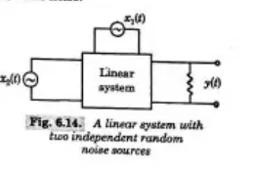
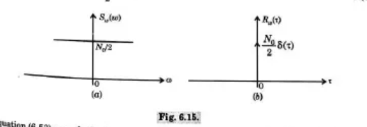
Fig 6.15 – Power spectrum and autocorrelation

Slide 28
Since the power density spectrum of thermal and shot noise are independent of operating frequencies, thermal noise and shot noise can be treated as white Gaussian noise for practical purposes.
The power spectrum of white noise is expressed as:
Sₙ(ω) = N₀ / 2
Half of the noise power is associated with positive frequencies and the remaining half with negative frequencies.

Slide 29
The autocorrelation function of white noise is obtained as:
Rₙ(τ) = (N₀ / 2) δ(τ)
The autocorrelation function contains a delta function scaled by N₀/2 and located at τ = 0.
Strictly speaking, white noise has infinite average power and hence it is not physically realizable.
However, it provides convenient mathematical properties and is widely used in communication system analysis.

Slide 30
